Slide 1
CV WRITING
Objectives
How to write your CV / Resume.

Slide 2
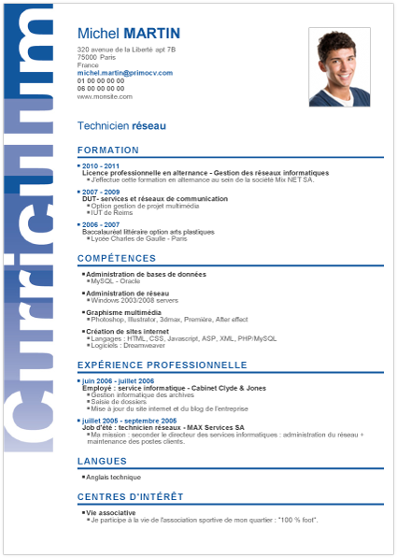
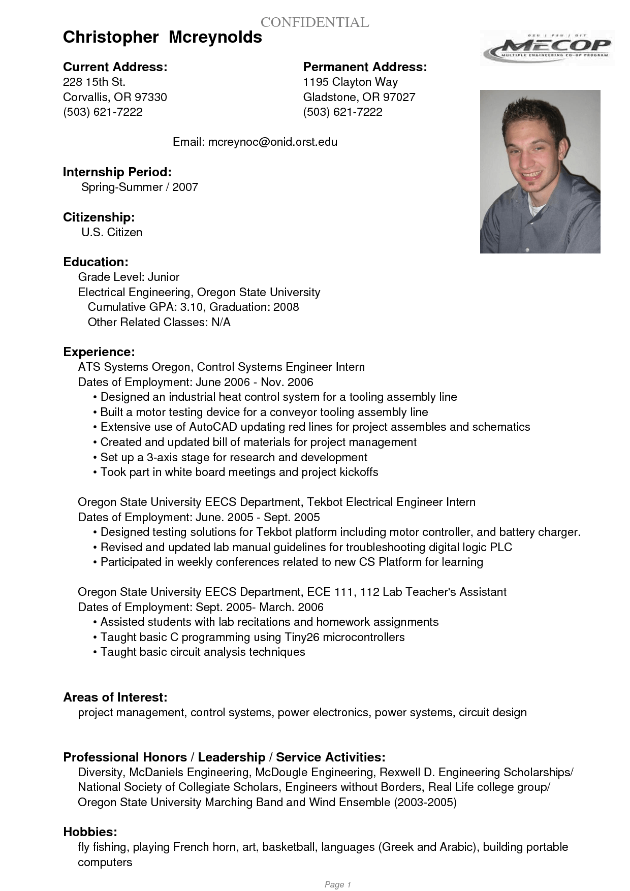

Slide 3
What are the main differences you can notice between the French and US resumés presented above?

Slide 4
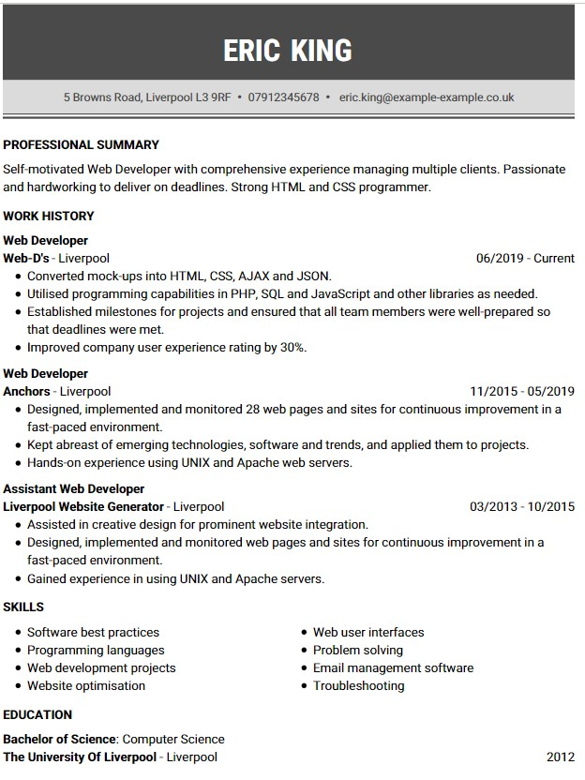

Slide 5
What are the different sections to include in a CV (UK) / Resume (US)?
Contact details
Personal profile
Work experience
Skills & achievements
Education
Interests
References

Slide 6
Contact details
Full name at the top of the page - no need to add 'CV' or 'curriculum vitae’
Home address
Phone number (which employers can reach you on during the working day)
Email address - always use a professional sounding email address
You can also provide a link to your professional networking profile, like LinkedIn.
Do not include your age, date of birth, marital status or nationality.

Slide 7
Personal profile
This is a few short lines that sum up who you are and what you hope to do.
It should go just under your name and contact details.
Think about the job you want and what the employer is looking for. Make your profile sound like you're the right person for the job.

Slide 8
Work History
- Include placements, volunteering and any paid jobs you’ve had. List them from the most recent first, and include:
the employer details
the job title
the dates you worked there
what you did, usually 2 to 3 lines
- Use active words to highlight your strengths and skills, to describe things you've done like:
• Organised • created • built • managed • planned
Give positive examples of your achievements rather than just listing responsibilities.

Slide 9
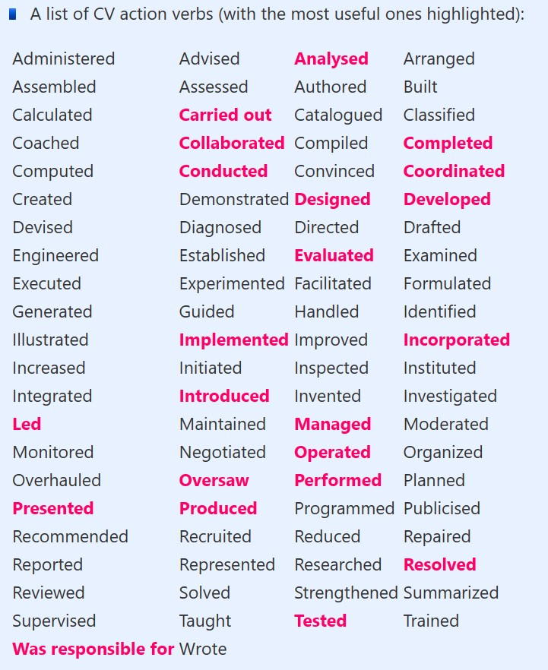

Slide 10
Skills & achievements
This is where you talk about the foreign languages you speak and the IT packages you can competently use.
The key skills that you list should be relevant to the job.

Slide 11
Education history
You can add this section after your personal profile if you are early on in your career. If you’re older and already have experience, place it after your work history and skills.
Whatever order you choose, include:
names of your qualifications
school, college or university where you studied
dates you attended

Slide 12
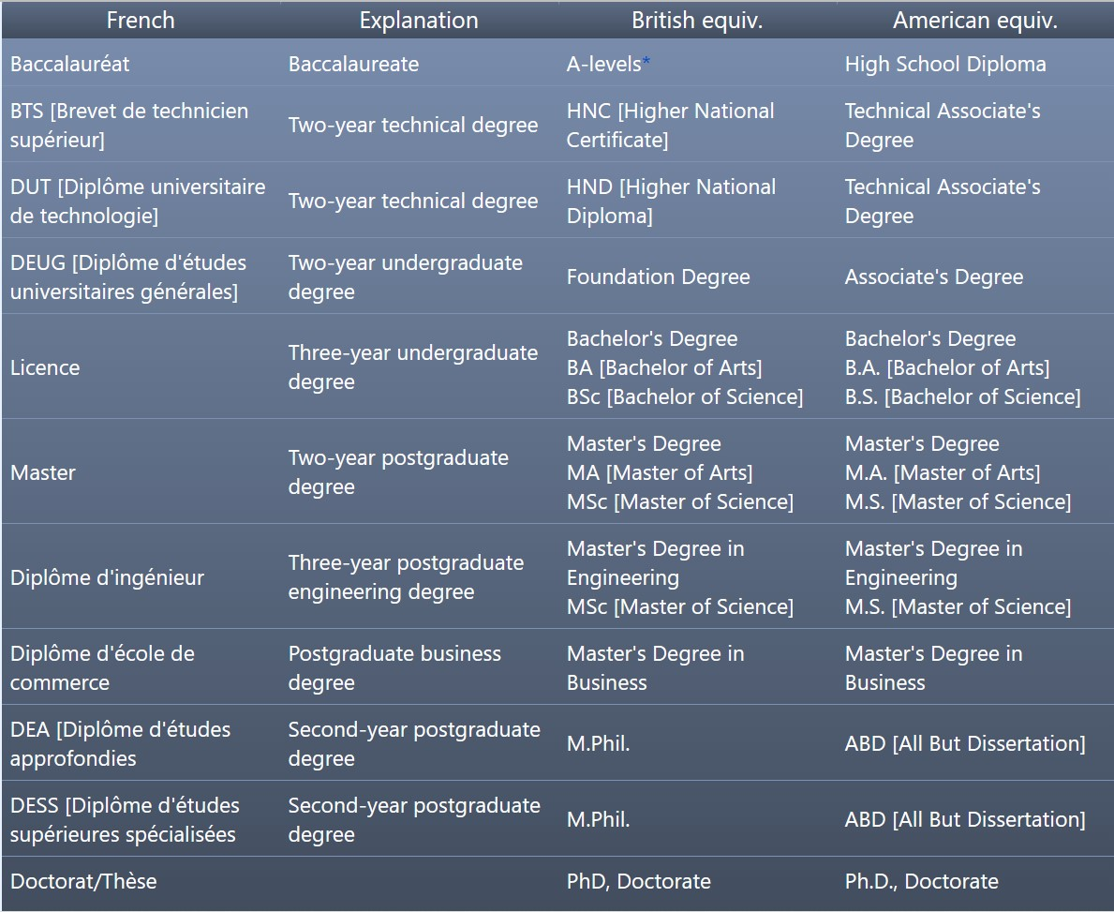

Slide 13
Interests
Try to show the skills you have through your hobbies and interests.
Focus on examples that show you have relevant skills for the job.
This section of a CV is useful if you do not have much work experience.

Slide 14
References
You can leave out the details of your references at this point, or mention that 'references are available on request'.
The recruiter will ask for these when you get through to the next stage.

